Slide 1
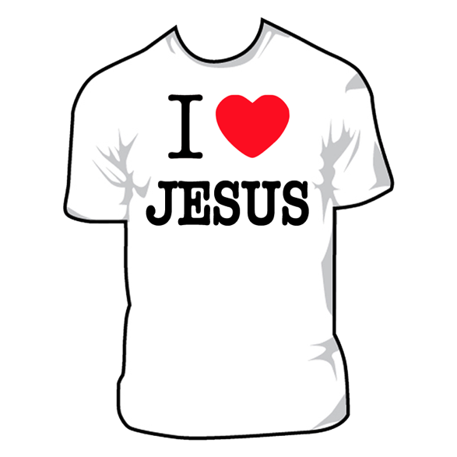
In Pursuit Of Righteousness
What It Really Means To
“Put On The Lord Jesus Christ”
(Romans 13.14)

Slide 2
In Pursuit Of Righteousness
David said, “The Lord will repay each man for his righteousness and his faithfulness…” (1 Sam 26.23).
That makes it sound like people have different degrees of righteousness.
But aren’t we all clothed in “the righteousness of Christ”?

Slide 3
In Pursuit Of Righteousness
NO.
The phrase
“righteousness of Christ”
does not occur anywhere in the Bible.

Slide 4
In Pursuit Of Righteousness
Furthermore, the biblical metaphor of “being clothed”
has to do the expression of an inward quality, or the execution of a purpose;
not with how one is “legally” or “positionally” viewed by another.

Slide 5
In Pursuit Of Righteousness
Thus, the Spirit of Messiah says,
“I will rejoice greatly in the Lord,
My soul will exult in my God;
For He has clothed me with garments of salvation,
He has wrapped me with a robe of righteousness…
For … the Lord God will cause righteousness and praise to spring up before all the nations.”
Isaiah 61.10-11

Slide 6
In Pursuit Of Righteousness
Thankfully, we are “justified in Christ,” and He has become our righteousness.
See Galatians 2.17; 1Corinthians 1.30;
cf. Jeremiah 23.6; 33.16.

Slide 7
In Pursuit Of Righteousness
However, this means that Christ is the basis of our righteousness, not that God is blind to our personal behavior.

Slide 8
In Pursuit Of Righteousness
A Source of Confusion:
Failure to recognize two kinds of righteousness in Scripture.

Slide 9
In Pursuit Of Righteousness
The 2 Kinds of Righteousness:
Relational (Genesis 15.6).
Ethical (Philippians 3.6-9).

Slide 10
In Pursuit Of Righteousness
Then he believed in the Lord;
and He reckoned it to him as righteousness.
For what does the Scripture say? “Abraham believed God, and it was credited to him as righteousness.”
Genesis 15.6; Romans 4.3

Slide 11
In Pursuit Of Righteousness
“… as to the righteousness which is in the Law, found blameless.
But whatever things were gain to me, those things I have counted as loss … that I may gain Christ,
and may be found in Him, not having a [my] righteousness of my own derived from the Law, but that which is through faith[fulness of] Christ, the righteousness which comes from God on the basis of faith …”
Philippians 3.6-9

Slide 12
In Pursuit Of Righteousness
The 2 Kinds of Righteousness:
Relational (Right Relationship).
Ethical (Right Behavior).

Slide 13
In Pursuit Of Righteousness
For You do not delight in sacrifice,
otherwise I would give it;
You are not pleased with burnt offering.
The sacrifices of God are a broken spirit;
A broken and a contrite heart, O God,
You will not despise.
Psalm 51.16-17

Slide 14
In Pursuit Of Righteousness
The 2 Kinds of Righteousness:
Relational (Justifies).
Ethical (Does NOT Justify).

Slide 15
In Pursuit Of Righteousness
The 2 Kinds of Righteousness:
Relational (Gift from God).
Ethical (Pursued by Grace);
See 1 Timothy 6.11.

Slide 16
In Pursuit Of Righteousness
Conclusion:
Our righteousness, whether relational or ethical, is truly our own though it is a gift from God and only possible through Jesus.

Slide 17
In Pursuit Of Righteousness
Conclusion:
Having trusted in Christ, we are justified and secure in God’s family by our relational righteousness; we must now pursue ethical righteousness (Matthew 6.33). By the pursuit of righteousness, we become the Bride made ready (Colossians 1.28; Revelation 19.7-8).

Slide 18
In Pursuit Of Righteousness
Conclusion:
To “put on Christ” means to identify with Him by our baptism (Galatians 3.27) and by our daily acts of Christ-like righteousness (Ephesians 4.24; Colossians 3.12-14).

Slide 19
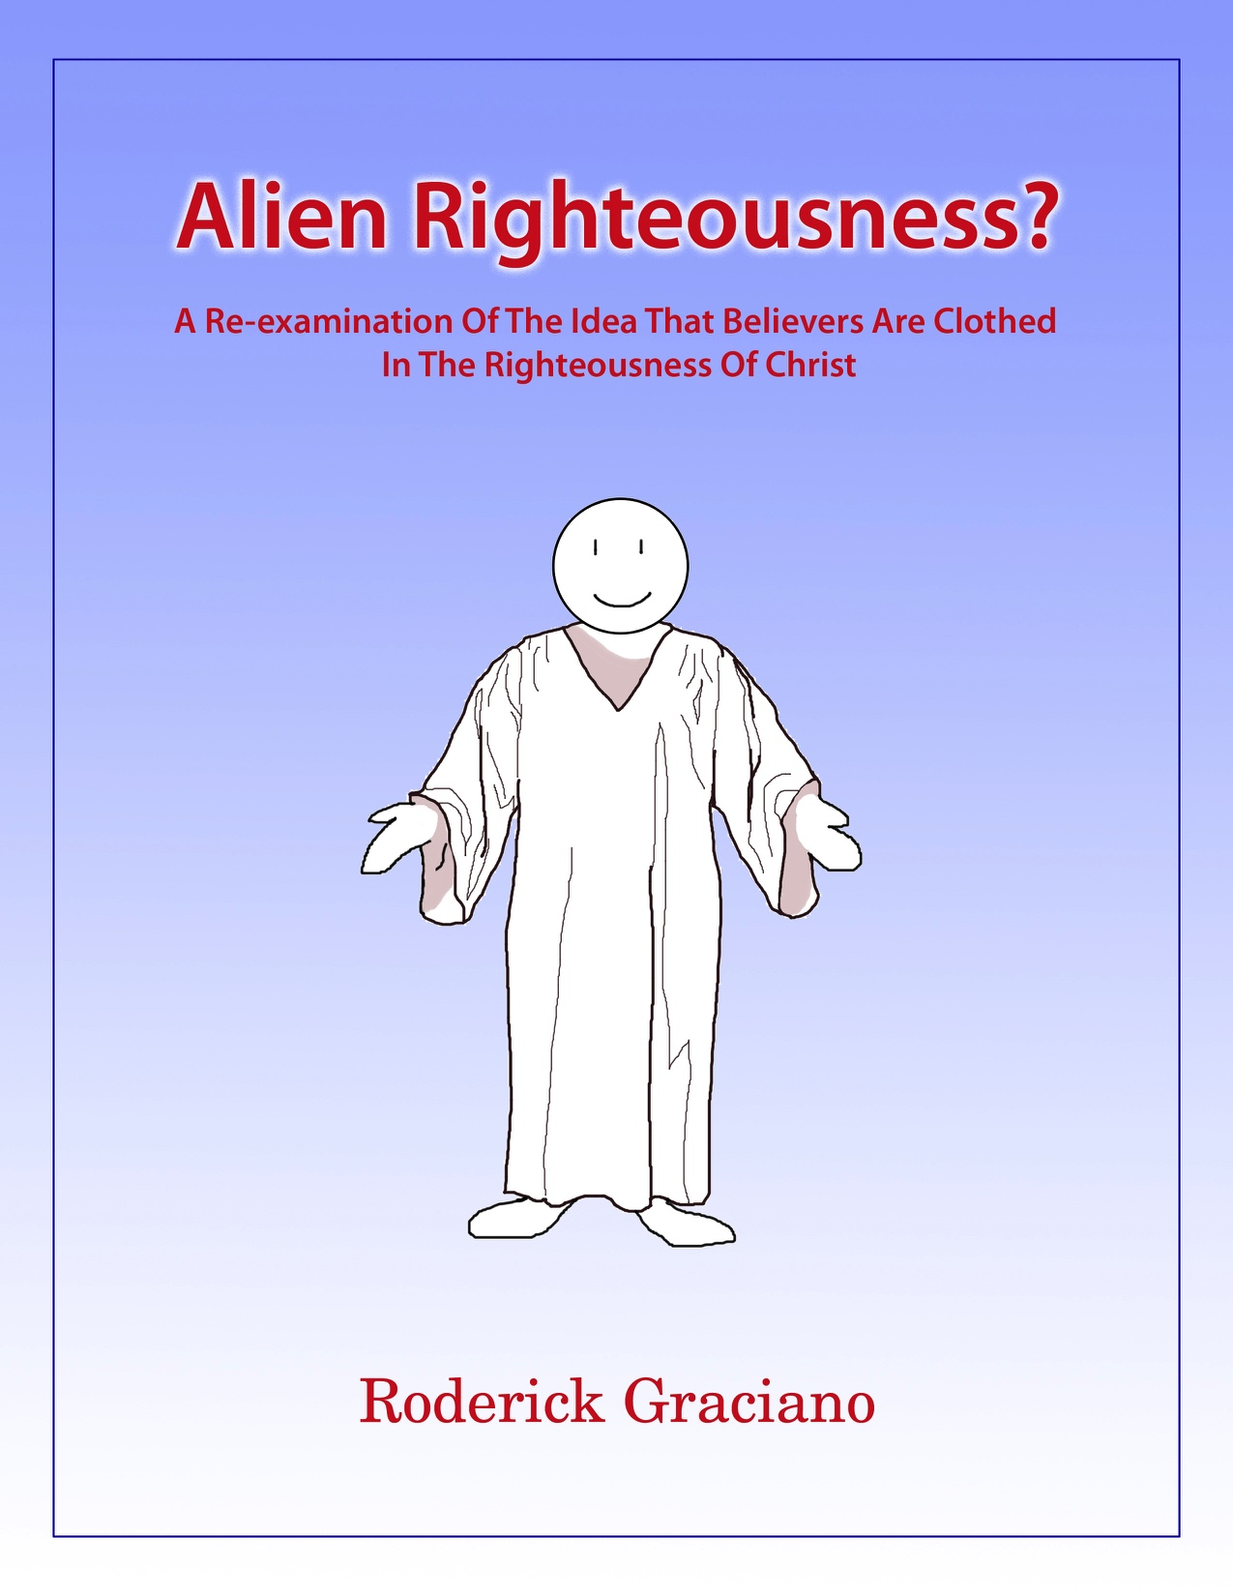
Advertisement: Alien Righteousness?
A free book by Roderick Graciano, in PDF or Logos Bible Software® format.
Get it at timothyministries.info

Slide 20
In Pursuit Of Righteousness
What It Really Means To
“Put On The Lord Jesus Christ”
(Romans 13.14)

