Slide 1
The Sine Qua Nons of Heaven
Those Things Without Which
Heaven Would Not Be Heaven

Slide 2
The Sine Qua Nons of Heaven
Those Things Without Which
Heaven Would Not Be Heaven

Slide 3

The
Sine Qua Nons
Of Heaven
Imagine you could eat as much as you wanted of anything you liked, without ill effects...

Slide 4
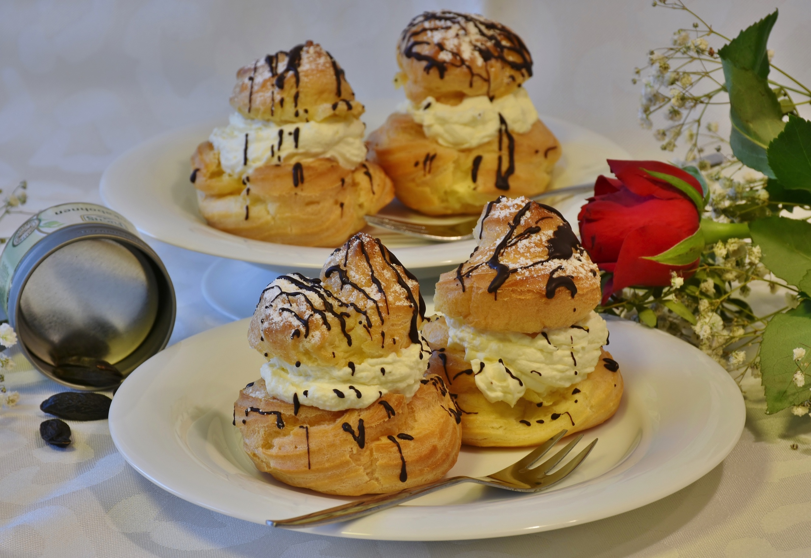
The
Sine Qua Nons
Of Heaven

Slide 5
The
Sine Qua Nons
Of Heaven
Imagine you could eat as much as you wanted of anything you liked, without ill effects...
so long as you ate alone.

Slide 6
The
Sine Qua Nons
Of Heaven
Imagine playing any sport you wanted, whenever you wanted, and with a champion’s skill…

Slide 7
The
Sine Qua Nons
Of Heaven
Imagine playing any sport you wanted, whenever you wanted, and with a champion’s skill…
but always against robots, with no spectators, and no one to talk to afterwards.

Slide 8
The
Sine Qua Nons
Of Heaven
Imagine exploring breathtakingly beautiful worlds and discovering amazing creatures…

Slide 9
The
Sine Qua Nons
Of Heaven
Imagine exploring breathtakingly beautiful worlds and discovering amazing creatures…
but never being able to share your experiences.

Slide 10
The
Sine Qua Nons
Of Heaven
Sine Qua Non 1:
PERSONAL RELATIONSHIP

Slide 11
The
Sine Qua Nons
Of Heaven
Sine Qua Non 1:
Personal Relationship requires:
Continuity of unique identity (Revelation 2.17)

Slide 12
The
Sine Qua Nons
Of Heaven
Sine Qua Non 1:
Personal Relationship requires:
Continuity of unique identity (Revelation 2.17)
Recognizability (Luke 16.9)
Notes:
If we use our assets to make friends now, and those friends die and go to heaven before us, they will be waiting to welcome us at the pearly gates!

Slide 13
The
Sine Qua Nons
Of Heaven
What if Heaven had every conceivable pleasure except for love?

Slide 14
The
Sine Qua Nons
Of Heaven
What if Heaven had every conceivable pleasure except for love?
What if someone “loved” you, but had no interest in your thoughts and dreams?

Slide 15
The
Sine Qua Nons
Of Heaven
Sine Qua Non 2:
INTIMACY
Notes:
We're not talking about a surface, sensual and fleeting intimacy here, but intimacy as biblically defined, and the intimacy that all our hearts long for, namely …

Slide 16
The
Sine Qua Nons
Of Heaven
Sine Qua Non 2:
INTIMACY
To be completely loved while fully known.
(cf. 1 Corinthians 13.12b)
Notes:
Many of us fear that if people really knew us, they wouldn't even want to be around us. We all long for a friend who will love us even when we take off all our masks. We all want to be loved by someone who really knows us …

Slide 17
The
Sine Qua Nons
Of Heaven
Sine Qua Non 2:
Wait! We can’t even know ourselves intimately, apart from relationship with our Creator and Redeemer.

Slide 18
The
Sine Qua Nons
Of Heaven
Sine Qua Non 2:
No one can really know themselves if they do not know their origin, purpose and destiny.

Slide 19
The
Sine Qua Nons
Of Heaven
Sine Qua Non 2:
Ultimate intimacy is only possible through the One Who knows our heart, gave us our gifts, and planned our destiny.
(cf. Psalm 36.9)
Notes:
Ps 36. 9 For with thee is the fountain of life: in thy light shall we see light.

Slide 20
The
Sine Qua Nons
Of Heaven
Sine Qua Non 3:
JESUS
Our infinite, omniscient Creator, and Redeemer.

Slide 21
The
Sine Qua Nons
Of Heaven
JESUS
Preceded Heaven.

Slide 22
The
Sine Qua Nons
Of Heaven
JESUS
Preceded Heaven.
Created Heaven and Earth (John 1.3).

Slide 23
The
Sine Qua Nons
Of Heaven
JESUS
Preceded Heaven.
Created Heaven and Earth (John 1.3).
Tied His eternal destiny to ours (John 1.14).

Slide 24
The
Sine Qua Nons
Of Heaven
JESUS
Guarantees our eternal joy (Psalm 16.11).
Endured the cross for the supreme joy of redeeming those He loves (Hebrews 12.2).
Notes:
Ps 16. 11 … In Your presence is fullness of joy;
In Your right hand there are pleasures forever.

Slide 25
The
Sine Qua Nons
Of Heaven
JESUS
IS THE ULTIMATE
SINE QUA NON
OF HEAVEN.
Notes:
Anyone uninterested in Jesus, will not want to go to heaven (if they know what heaven is all about). Contra the popular imagination, who would want to golf or fish 24-7 for all eternity?
Jesus is the ultimate sine qua non of heaven, but let me enlarge upon this idea with what we call The Theology Of The Bride.

Slide 26
The
Sine Qua Nons
Of Heaven
The Theology Of The Bride
The reason for all creation is the overflow of the Father’s love for the Son. The expression of the Father’s love will be multiplied as He builds a suitable Bride for His Son.
Notes:
The Theology of the Bride is one way to understand the overarching story of the Bible.
Typified in the building of Eve from Adam’s wounded side.

Slide 27
The
Sine Qua Nons
Of Heaven
The Theology Of The Bride
As the people of God, we are living out a cosmic courtship; we are preparing for a Jewish-type wedding.
The “friend of the Bridegroom,” John the Baptist has already prepared the way and introduced the Bridegroom (John 3.29-30).

Slide 28
The
Sine Qua Nons
Of Heaven
The Theology Of The Bride
By our Christian baptism we have received the traditional prenuptial immersion.

Slide 29
The
Sine Qua Nons
Of Heaven
The Theology Of The Bride
The marriage contract, the “Ketubah,” has been presented by the Bridegroom in His “Sermon On The Mount.”
Notes:
The marriage contract can be thought of as the “house rules” or “family rules” to which the parties agree.

Slide 30
The
Sine Qua Nons
Of Heaven
The Theology Of The Bride
In our taking communion, we enact the betrothal (eyrusin) ceremony of sharing a cup of wine, and our betrothal is lived out in our continuing sanctification (kiddushin).

Slide 31
The
Sine Qua Nons
Of Heaven
The Theology Of The Bride
In the traditional manner, our Bridegroom has gone to prepare a place for us (John 14.2-3).

Slide 32
The
Sine Qua Nons
Of Heaven
The Theology Of The Bride
Our Bridegroom will return for us, according to the traditional “fetching of the Bride,” a tradition that provides the background for the parable of “The Ten Virgins” (Matthew 25.1-13).

Slide 33
The
Sine Qua Nons
Of Heaven
The Theology Of The Bride
At last, the lavish wedding will take place, when God will turn the hill country around Jerusalem into a great plain (Zechariah 14.10), and the fiery cloud of His presence, the Shekinah, will serve as the wedding canopy (chuppah) over it all (Isaiah 4.5).

Slide 34
The
Sine Qua Nons
Of Heaven
So, can we tune our hearts to Psalm 73.25?
“Whom have I in heaven but you?
And earth has nothing I desire besides you.”
Notes:
Comment on how this is easier for women than for men.
King Jesus seeks a relationship with men like that of King David with his "Mighty Men" described in 2Sam.

Slide 35
The
Sine Qua Nons
Of Heaven
So, can we tune our hearts to Psalm 73.25?
“Whom have I in heaven but you?
And earth has nothing I desire besides you.”
Can we get excited about our coming wedding?
Notes:
Comment on how this is easier for women than for men.
King Jesus seeks a relationship with men like that of King David with his "Mighty Men" described in 2Sam.

Slide 36
The Sine Qua Nons of Heaven
Those Things Without Which
Heaven Would Not Be Heaven
Download these materials at: www.tmin.org/tminpages/Heaven.html
Questions? Email Rod: rod@tmin.org

