Slide 1
The Rewards of Heaven
The Good News
In Addition To
THE GOOD NEWS

Slide 2
A Good King and an evil king in neighboring countries wage a great war. The evil king takes prisoners and puts them in chains to await torture and execution. He tells the Good King that the prisoners can be redeemed, but only for a price equivalent to 700-years’ wages each. The Good King sends word to his people who are condemned in the foreign land, saying, “I offer to pay your redemption price and repatriate you, all as a free gift. When you return home, I will give you suitable employment in my government.” All the prisoners accept their Good King’s offer with rejoicing. They come safely home and go to work in their Good King’s government.

Slide 3

Now, an important question:
Should the Good King’s redeemed and repatriated citizens expect wages as they go to work in His government?

Slide 4
Answer:
YES, the Good King’s redeemed citizens should expect wages for their work because:
The King’s own law says, “the laborer is worthy of his wages” (Luke 10.7).

Slide 5
Answer:
YES, the Good King’s redeemed citizens should expect wages for their work because:
The King’s own law says, “the laborer is worthy of his wages” (Luke 10.7).
The King will not allow confusion about Who paid for the redemption.

Slide 6
Answer:
YES, the Good King’s redeemed citizens should expect wages for their work because:
The King’s own law says, “the laborer is worthy of his wages” (Luke 10.7).
The King will not allow confusion about Who paid for the redemption.
The King will not allow suspicion about the free, gratis nature of His redemption.

Slide 7
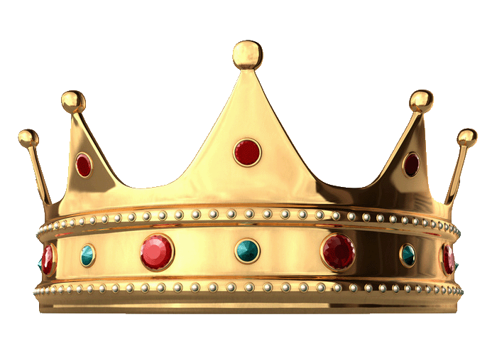
The
Rewards Of Heaven
Hebrews 11.6 says,
“… he who comes to God must believe that He is and that He is a wage-payer (misthapothotes) of those who seek Him.”
Notes:
Scripture often tells us to believe, but only in Heb 11.6 does it tell us that we must believe specific elements of God's identity or character.

Slide 8

Two understandings of the Christian life:
1.
I’m saved from Hell, my
sins are forgiven; now
I can live my life
without worries!

Slide 9
Two understandings of the Christian life:
2.
God has saved me and
called me into His work;
now I can serve Him and
be rewarded for it!

Slide 10
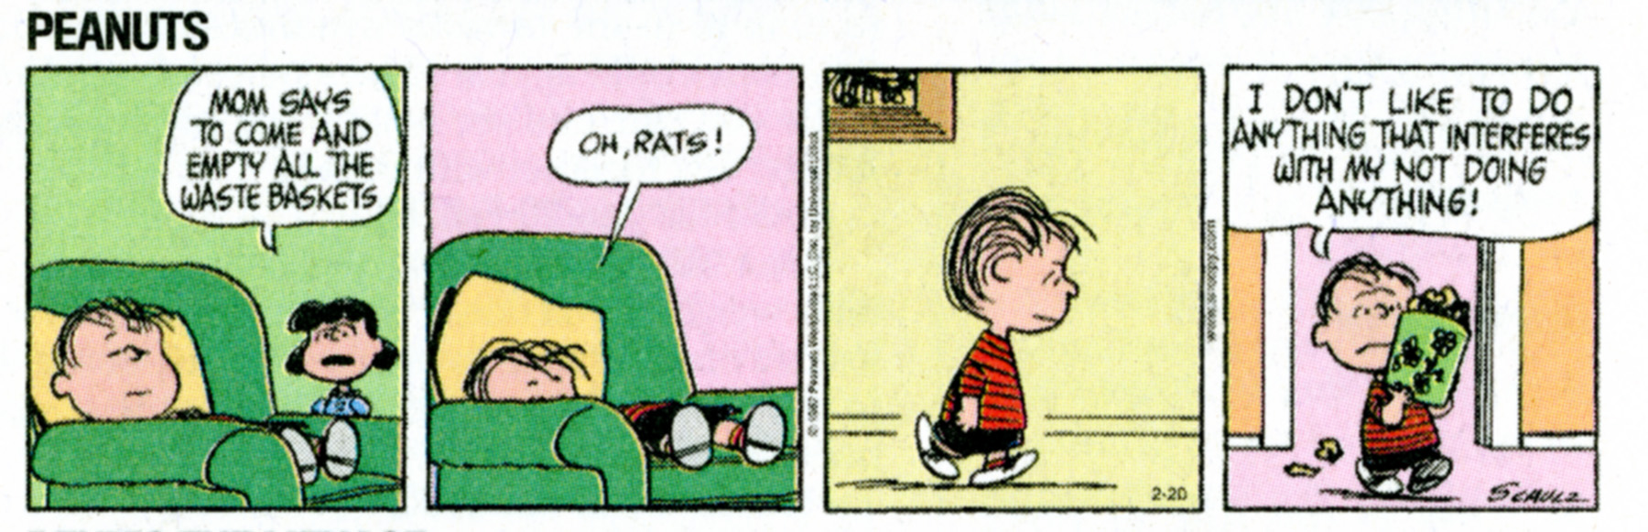
The
Rewards Of Heaven
Why is it hard for Evangelical Christians to believe that God rewards His people?

Slide 11
The
Rewards Of Heaven
Why is it hard for Evangelical Christians to believe that God rewards His people?
We’re lazy. We’re too happy to accept God’s free gift without having to think about good works. (But see Ephesians 2.10 and 1John 3.7!)
need only teach clearly that rewards come after salvation. Christ’s encouragement to “store up treasures in heaven” (Matthew 6.20) implies a future reward.

Slide 12
The
Rewards Of Heaven
Why is it hard for Evangelical Christians to believe that God rewards His people?
We want to protect the doctrine of salvation by grace apart from works—but we need only teach clearly that rewards come after salvation. Christ’s encouragement to “store up treasures in heaven” (Matthew 6.20) implies a future reward.

Slide 13
The
Rewards Of Heaven
Why is it hard for Evangelical Christians to believe that God rewards His people?
We want to protect the doctrine of salvation by grace apart from works— but we need only teach clearly that rewards come after salvation. Christ’s encouragement to “store up treasures in heaven” (Matthew 6.20) implies a future reward. we need only teach clearly that rewards come after salvation. Christ’s encouragement to “store up treasures in heaven” (Matthew 6.20) implies a future reward.
Notes:
Future, as opposed to, “store up treasures in heaven in order to be saved now.”

Slide 14
The
Rewards Of Heaven
Why is it hard for Evangelical Christians to believe that God rewards His people?
We’ve been conditioned to believe that we glorify God by not doing stuff.
need only teach clearly that rewards come after salvation. Christ’s encouragement to “store up treasures in heaven” (Matthew 6.20) implies a future reward.

Slide 15

The
Rewards Of Heaven
Would a marriage succeed if both spouses did nothing more than stay out of each other’s way, trying not to offend each other?

Slide 16
The
Rewards Of Heaven
Yet this is the approach many take to their relationship with God.

Slide 17
The
Rewards Of Heaven
Yet this is the approach many take to their relationship with God. It is the Buddhist approach to Christianity:
“ Hurt not others with that which pains yourself. ”
Udanavarga 5.18 (560 BC)

Slide 18
The
Rewards Of Heaven
It is also the Confucian approach to Christianity:
“What you do not want done to yourself, do not do to others.”
Analects of Confucius 15.23 (after 479 BC)

Slide 19
The
Rewards Of Heaven
No, we glorify and please God by what we DO, more than by what we don’t do. It should not surprise us that He rewards us for what we do (1Corinthians 3.8).
“Do to others as
you would have them do to you.”
Jesus in Luke 6.31 (NIV)

Slide 20
The
Rewards Of Heaven
Does the Bible really teach rewards?
Yes, the apostle Paul wrote:
“With good will render service, as to the Lord, and not to men, knowing that whatever good thing each one does, this he will receive back from the Lord…”
(Ephesians 6.7-8)

Slide 21
The
Rewards Of Heaven
Reimbursement is coming!
Paul also wrote:
“For we must all appear before the judgment seat of Christ, so that each one may be recompensed for his deeds in the body, according to what he has done, whether good or bad.”
(2 Corinthians 5.10)

Slide 22
The
Rewards Of Heaven
What will God reward us for?
Giving to the poor (Matthew 19.21; Luke 14.13-14): “But when you give a reception, invite the poor, the crippled, the lame, the blind, and you will be blessed, since they do not have the means to repay you; for you will be repaid at the resurrection of the righteous.”

Slide 23
The
Rewards Of Heaven
What will God reward us for?
Extending hospitality (Matthew 10.41-42): “He who receives a prophet in the name of a prophet shall receive a prophet’s reward; and he who receives a righteous man in the name of a righteous man shall receive a righteous man’s reward. And whoever in the name of a disciple gives to one of these little ones even a cup of cold water to drink, truly I say to you, he shall not lose his reward.”

Slide 24
The
Rewards Of Heaven
What will God reward us for?
Loving our enemies (Luke 6.35): “But love your enemies, and do good, and lend, expecting nothing in return; and your reward will be great...”

Slide 25
The
Rewards Of Heaven
What will God reward us for?
Enduring persecution (Matthew 5.11; Luke 6.22-23): “Blessed are you when men hate you, and ostracize you, and insult you, and scorn your name as evil, for the sake of the Son of Man. Be glad in that day and leap for joy, for behold, your reward is great in heaven.”

Slide 26
The
Rewards Of Heaven
What will God reward us for?
Making disciples (1Cor. 3.10-17; 1Peter 2.5): “If any man builds on the foundation with gold, silver, precious stones, wood, hay, straw, each man’s work will become evident; for … the fire itself will test the quality of each man’s work. If any man’s work … remains, he will receive a reward. If any man’s work is burned up, he will suffer loss; but he himself will be saved, yet so as through fire.”

Slide 27
The
Rewards Of Heaven
When will God reward us?
Now, in the present age (Mark 10.29-30).
In the coming Day of the Lord (1Corinthians 3.13-14; 2Timothy 4.8).
When Jesus comes (Revelation 22.12); i.e., when the King takes full possession of His kingdom (Luke 19.12-19).
Notes:
Mark 10: Now: houses, brothers, sisters, mothers, children, farms, persecution; In Age To Come: eternal life.
2Ti 4.8: Future: crown of righteousness.
Lk 19: When king returns: authority over cities.

Slide 28
The
Rewards Of Heaven
What will we receive as rewards?
Family, houses, farms (Mark 10.28-30).
A crown and robe of righteousness (2Timothy 4.8; Revelation 19.7-8).
Authority over cities and nations (Luke 19.12-19; Revelation 2.26-27).
Praise from God (Matthew 25.21,23; 1 Corinthians 4.5).

Slide 29
The
Rewards Of Heaven
These are in addition to what we already have in Christ:
Eternal life (Mark 10.30; Rev 2.17).
The Heavenly City, New Jerusalem (Hebrews 11.10,16; Revelation 22.14).
Ever-deepening relationship with Jesus Himself (Revelation 2.17).
Promise of a Jerusalem wedding (Isaiah 4.5; 25.6-7; Revelation 19.7-9).
Notes:
Eternal life is both a present and a future reward; the fullness of eternal life comes with our immortal glorified bodies.
Re 2.17: "To him who overcomes, to him I will give some of the hidden manna, and I will give him a white stone, and a new name written on the stone which no one knows but he who receives it."

Slide 30
The
Rewards Of Heaven
But Isn’t it wrong to do good works in hope of rewards?
It is foolish to pretend to do good works to gain the approval of men (Matthew 6.2,5),
But the great heroes of the faith performed their exploits in the hopes of obtaining “a better resurrection” (Hebrews 11.35)!

Slide 31
The
Rewards Of Heaven
But Isn’t it wrong to do good works in hope of rewards?
Furthermore, giving thought to earning rewards from God cannot help but train our hearts to please God; thinking about rewards from God will bring our hearts into alignment with God’s heart.
Notes:
Like teaching children to brush their teeth or make their beds.

Slide 32

The
Rewards Of Heaven
Let’s forget our excuses,
and put our hearts into storing up treasure in heaven (Luke 12.32-34)! Our hurting world needs the love of Jesus shared through us.

Slide 33
The Rewards of Heaven
Download these materials at: www.tmin.org/tminpages/Heaven.html
Questions? Email Rod: rod@tmin.org

