Slide 1
The
Kingdom of Heaven
And Its Sarim

Slide 2
The
Kingdom of Heaven
And Its Sarim
(Sarim = Royal Leaders)

Slide 3
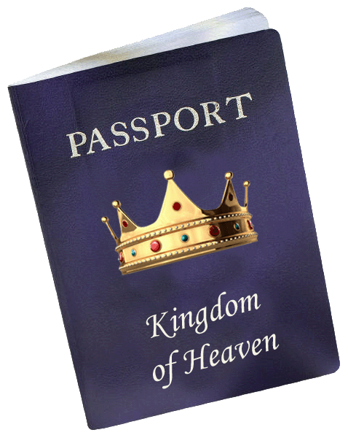
The
Kingdom of Heaven
And Its Sarim
Heaven is a Kingdom.
Jesus is the King.

Slide 4
The
Kingdom of Heaven
And Its Sarim
Heaven is a Kingdom.
Jesus is the King.
The Kingdom is “among you” (Luke 17.21) because Jesus rules in believers, and through them!

Slide 5
The
Kingdom of Heaven
And Its Sarim
Our citizenship in the Kingdom began when we were spiritually born into it by the will of God (John 1.12-13; 3.3).
We were born to love and serve the King, but also to rule with Him.

Slide 6
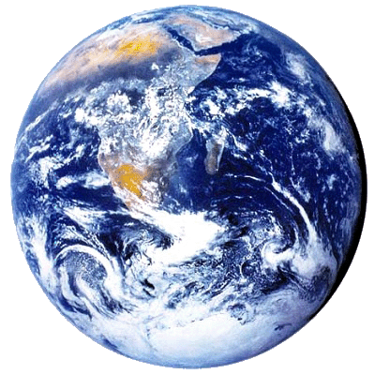
The
Kingdom of Heaven
And Its Sarim
God gave the dominion of the Earth to mankind (Gen 1.26-28).

Slide 7
The
Kingdom of Heaven
And Its Sarim
In Eden, man sold out his dominion to Satan.

Slide 8
The
Kingdom of Heaven
And Its Sarim
In Eden, man sold out his dominion to Satan.
Jesus redeemed it as our Kinsman (Lev 25.25).

Slide 9
The
Kingdom of Heaven
And Its Sarim
In Eden, man sold out his dominion to Satan.
Jesus redeemed it as our Kinsman (Lev 25.25).
God, through Christ, disarmed usurping authorities (Col 2.15).

Slide 10
The
Kingdom of Heaven
And Its Sarim
Legally, we have spiritual authority over our planet now (Matthew 28.19; Ephesians 1.18 to 2.7).

Slide 11
The
Kingdom of Heaven
And Its Sarim
Legally, we have spiritual authority over our planet now (Matthew 28.19; Ephesians 1.18 to 2.7).
We will receive pastoral authority over nations when Jesus returns (Rev 2.26-27; 5.9-10).
Notes:
Story of the dark antique store on Park Ave.

Slide 12
The
Kingdom of Heaven
And Its Sarim
Revelation 2.26-27
‘He who overcomes, and he who keeps My deeds until the end, to him I will give authority over the nations; and he shall rule (Greek = shepherd/pastor) them with a rod of iron, as the vessels of the potter are broken to pieces, as I also have received authority from My Father …

Slide 13
The
Kingdom of Heaven
And Its Sarim
WAIT! Will there still be people on the earth after “Armageddon”?

Slide 14
The
Kingdom of Heaven
And Its Sarim
WAIT! Will there still be people on the earth after “Armageddon”?
Yes! Millions!
See: Isaiah 66.19-24; Micah 4.1-7; Zechariah 2.11; 8.1-5; 14.16; Zephaniah 3.8-10.

Slide 15
The
Kingdom of Heaven
And Its Sarim
BUT WAIT! Aren’t we going to Heaven when we die?

Slide 16
The
Kingdom of Heaven
And Its Sarim
BUT WAIT! Aren’t we going to Heaven when we die?
Yes, but Heaven is coming to Earth (Rev 21.2-3). Our future destiny is largely on the Earth (old Earth and new, Rev 21.1).

Slide 17
The
Kingdom of Heaven
And Its Sarim
Key insight: There are three ways humans experience heaven.
While in our mortal bodies.
As disembodied spirits in heaven after we die.
And in immortal, glorified bodies. This is God’s ultimate destiny for His people.
Notes:
1Co 15. 42 So also is the resurrection of the dead. It is sown a perishable body, it is raised an imperishable body;
43 it is sown in dishonor, it is raised in glory; it is sown in weakness, it is raised in power;
44 it is sown a natural body, it is raised a spiritual body.

Slide 18
The
Kingdom of Heaven
And Its Sarim
Key insight: In our immortal bodies, resurrected and transformed at Christ’s return, we will be able to go back and forth between heaven and earth, just like He does (cf. 1Jn 3.2).

Slide 19
The
Kingdom of Heaven
And Its Sarim
Key insight: In our immortal bodies, resurrected and transformed at Christ’s return, we will be able to go back and forth between heaven and earth, just like He does (cf. 1Jn 3.2).
Our work of reigning with Christ will take place largely on earth.

Slide 20
The
Kingdom of Heaven
And Its Sarim
What will
our future reign
look like?

Slide 21
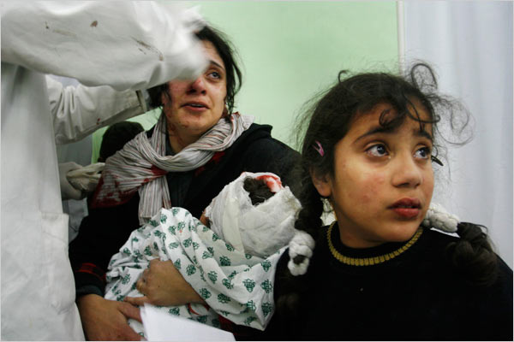
The
Kingdom of Heaven
And Its Sarim
It will begin with ministering to traumatized people...

Slide 22
The
Kingdom of Heaven
And Its Sarim
Isaiah 32 describes this time:
¹ Behold, a king will reign righteously And princes [sarim] will rule justly.
² Each will be like a refuge from the wind And a shelter from the storm, Like streams of water in a dry country, Like the shade of a huge rock in a parched land. (NASB)

Slide 23
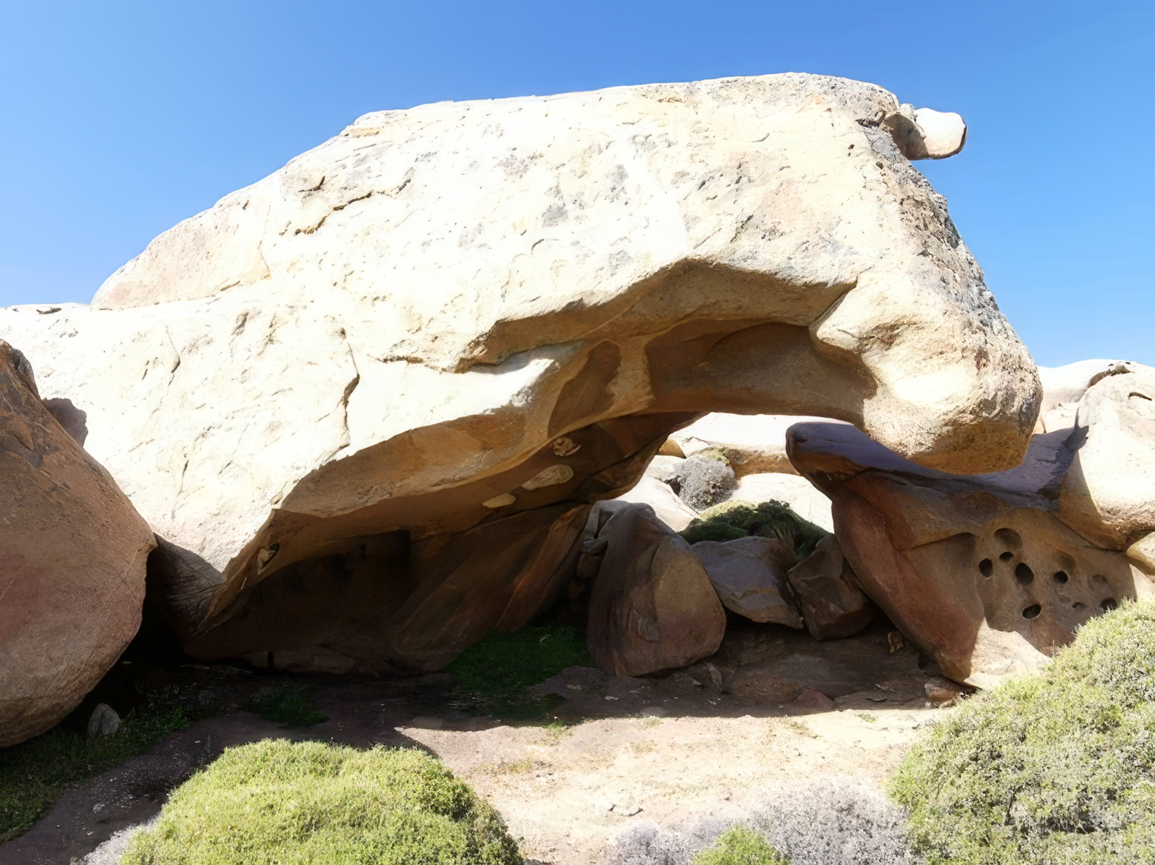
The
Kingdom of Heaven
And Its Sarim
Cataviña Boulder Field
Sonoran Desert
Baja California

Slide 24
The
Kingdom of Heaven
And Its Sarim
Isaiah 32 describes this time:
³ Then the eyes…will not be blinded, And the ears…will listen.
⁴ The mind of the hasty will discern the truth, and the tongue of the stammerers will hasten to speak clearly. (NASB)
Compare this with 2Corinthians 4.4!

Slide 25
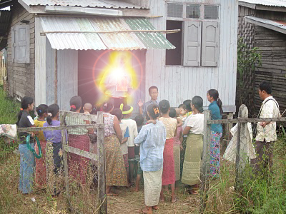
The
Kingdom of Heaven
And Its Sarim
We will continue to rule by shepherding towns & cities (Luke 19.12-19).

Slide 26
The
Kingdom of Heaven
And Its Sarim
Where will
we live?

Slide 27
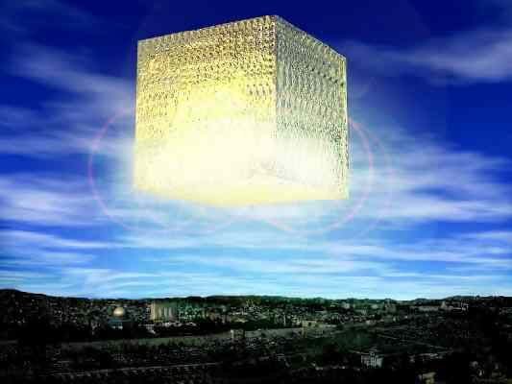
We will commute from New Jerusalem (Revelation 21.2; 22.14).
Notes:
Re 21. 24 The nations will walk by its light, and the kings of the earth will bring their glory into it.

Slide 28
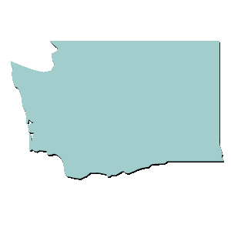
The
Kingdom of Heaven
And Its Sarim
New Jerusalem will not land on Earth; it’s a 1,500-mile cube.

Slide 29
The
Kingdom of Heaven
And Its Sarim
New Jerusalem has streets of gold and gatehouses carved out of giant pearls; it’s where our traditional heaven imagery comes from (Rev 21).

Slide 30
The
Kingdom of Heaven
And Its Sarim
Pearls are a symbol of value; no one enters this city who has not recognized the surpassing value of God’s Kingdom (Matthew 13.45-46).

Slide 31
The
Kingdom of Heaven
And Its Sarim
The city is cubical, the shape of the Holy of Holies (1Kings 6.20).
No one enters this city who is not holy.

Slide 32
The
Kingdom of Heaven
And Its Sarim
How will we
commute
between the
Heavenly City
and Earth?

Slide 33
The
Kingdom of Heaven
And Its Sarim
In our present bodies, we must move to another place slowly.
In our heavenly bodies, we will think ourselves to another place instantly (Cf. Luke 24.31).

Slide 34
The
Kingdom of Heaven
And Its Sarim
A more important
question:
Will we live now
in the light of
what’s ahead?

Slide 35
The
Kingdom of Heaven
And Its Sarim
Paul in Philippians 3.8-11 said:
⁸ I count all things to be loss…that I may gain Christ…
⁹ and be found in Him…
¹⁰ that I may know Him, and the power of His resurrection and the fellowship of His sufferings, being conformed to His death;
¹¹ in order that I may attain to the resurrection from the dead. (NASB)
Notes:
"Hope in Olam Ha-Ba was never meant to encourage withdrawal from the responsibilities of the present world. On the contrary, the expectation of God’s future kingdom called believers to lives of righteousness, compassion, repentance, and fidelity to the covenant. Every act of justice, every deed of loving-kindness, and every commitment to Torah was participation in the future God had promised to bring into being." — Bejarano Gutierrez, Juan Marcos. Jewish Views of Life After Death: Ancient Voices, Enduring Questions (p. 108).

Slide 36
The
Kingdom of Heaven
And Its Sarim

