Slide 1
Heaven
Is Where Your Heart Is
Matthew 6.19-21

Slide 2

Heaven
Is Where
Your Heart Is
Definitions
The Heavens: The spatial and spiritual realms that include:
1. The material heavens: our atmosphere and outer space,
2. The superior heavens: which include the domain of evil spirits, and the abode of angels and God.

Slide 3
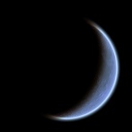

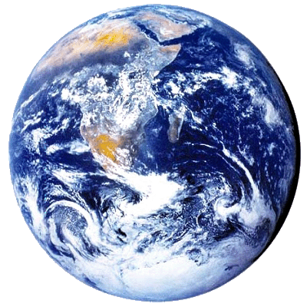
Heaven
Is Where
Your Heart Is
The Heavens 1
Atmosphere
Outer Space

Slide 4


Heaven
Is Where
Your Heart Is
The Heavens 2
Power Of
The Air
Highest Heavens
Notes:
Eph 2.2 … you formerly walked according to the course of this world, according to the prince of the power of the air, of the spirit that is now working in the sons of disobedience.
Eph 6.12 … our struggle is not against flesh and blood, but against the rulers, against the powers, against the world forces of this darkness, against the spiritual forces of wickedness in the heavenly places.
Deu 10.14 … to the Lord your God belong heaven and the highest heavens …
1Ki 8.27 … Behold, heaven and the highest heaven cannot contain You …
Ps 68.33 To Him who rides upon the highest heavens, which are from ancient times …

Slide 5
Heaven
Is Where
Your Heart Is
Definitions
Paradise: The Garden of God in the heavenly city, where Jesus met with the thief who died with Him (Luke 23.43).
The apostle Paul visited this garden in a vision (2Cor 12.4), and all the redeemed will enjoy its fruit in the future (Rev 2.7).

Slide 6
Heaven
Is Where
Your Heart Is
Definitions
Paradise: The Garden of God after which Adam’s home in Eden was modeled.
After Christ’s return, the restored land of Israel will reflect this heavenly Paradise (Isaiah 51.3).

Slide 7
Heaven
Is Where
Your Heart Is
Definitions
The Highest Heaven: Also called the Third Heaven, is the present abode of God, the place of His throne, and the location of Paradise. This is where Jesus currently sits and where believers go when their bodies die. It’s the nature of this Heaven that we’ll focus on today.
Notes:
2Co 12.2 … such a man was caught up to the third heaven.

Slide 8
Heaven
Is Where
Your Heart Is
Heaven did not always exist.

Slide 9
Heaven
Is Where
Your Heart Is
Heaven did not always exist.
God created Heaven, because He is inherently relational.

Slide 10
Heaven
Is Where
Your Heart Is
Heaven did not always exist.
God created Heaven, because He is inherently relational.
Heaven is the place where relationship can flourish between God and creatures made in His image.

Slide 11
Heaven
Is Where
Your Heart Is
What Is
Heaven Like?

Slide 12
Heaven
Is Where
Your Heart Is
We should not think of heaven…
as insubstantial. Heavenly bodies are more solid than material bodies. The resurrected Jesus walked through walls as we now walk through fog.

Slide 13
Heaven
Is Where
Your Heart Is
We should not think of heaven…
as inhospitable to bodily existence. In His glorified human body, Jesus is comfortable in both the earthly and heavenly realms. Heaven will feel familiar to us!

Slide 14
Heaven
Is Where
Your Heart Is
We should not think of heaven…
as filled with incomprehensible things. The apostle John was able to describe all that he saw in Heaven. Heaven will look familiar to us (with the addition of a few beings we don’t normally see on earth).

Slide 15
Heaven
Is Where
Your Heart Is
In fact,
earthly things are patterned after heavenly things, and heavenly things reflect God’s own heart.
This is why we can see aspects of God’s nature and character in His creation (Romans 1.20).

Slide 16

Heaven
Is Where
Your Heart Is
The implication of this:
everything we most love and long for in earthly existence, we will find more substantially and intensely real in Heaven.

Slide 17
Heaven
Is Where
Your Heart Is
Where is
Heaven?

Slide 18
Heaven
Is Where
Your Heart Is
Heaven is…
the context within which our universe exists. Heaven and our natural world coincide. (See Job 1.1-7; Isaiah 57.15; John 14.23)
“Earth is not outside of heaven; it is heaven’s workshop, heaven’s womb.” – Peter Kreeft
Notes:
Is 57.15 For thus says the high and exalted One
Who lives forever, whose name is Holy,
“I dwell on a high and holy place,
And also with the contrite and lowly of spirit
In order to revive the spirit of the lowly
And to revive the heart of the contrite.
Jn 14.23 Jesus answered and said to him, “If anyone loves Me, he will keep My word; and My Father will love him, and We will come to him and make Our abode with him.

Slide 19
Heaven
Is Where
Your Heart Is
Heaven is…
like the clear air that we pass through but do not see. When God temporarily attunes our senses to perceive Heaven, we have the sensation of the sky being peeled back.

Slide 20
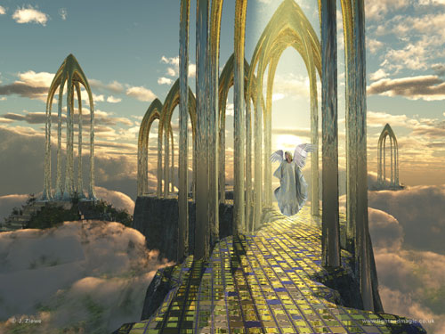

Slide 21
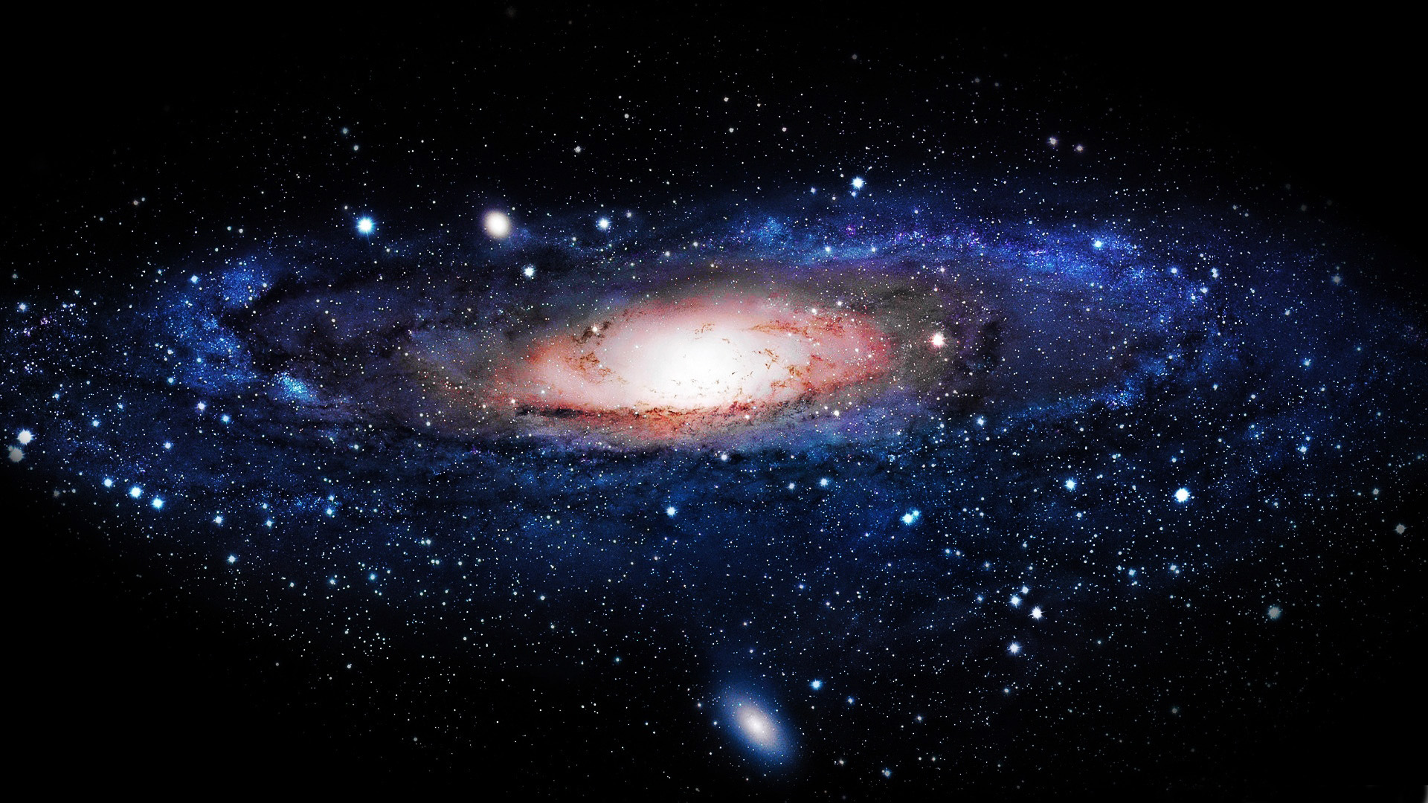
Heaven
Is Where
Your Heart Is
Heaven is not distant…
Is the Milky Way near or far?

Slide 22
Heaven
Is Where
Your Heart Is
Heaven is not distant…
Is the Milky Way near or far?
All the most important parts of our galaxy are near, beginning with the air we breath!

Slide 23
Heaven
Is Where
Your Heart Is
Heaven is so close that…
you’ve probably heard God’s voice. (See John 12.28-30; Acts 17.26-27.)
Notes:
Act 17.26-27 …He made from one man every nation of mankind to live on all the face of the earth, having determined their appointed times and the boundaries of their habitation, that they would seek God, if perhaps they might grope for Him and find Him, though He is not far from each one of us …

Slide 24
Heaven
Is Where
Your Heart Is
Heaven is so close that…
you’ve probably heard God’s voice. (See John 12.28-30; Acts 17.26-27.)
And you’ve stored treasure there! (See Matthew 6.19-21.)

Slide 25
Heaven
Is Where
Your Heart Is
Heaven is so close that…
if God attuned our eyes, we could see His angel armies arrayed around us (2 Kings 6.15-18), or Jesus at the right hand of God (Acts 7.55-56).

Slide 26
Heaven
Is Where
Your Heart Is
Heaven is so close that…
we can approach God’s throne right now (Hebrews 4.16), and if we were fully “in the spirit,” we could see God’s throne room as John did (Revelation 4.1-4).

Slide 27
Heaven
Is Where
Your Heart Is
Heaven is so close that…
we are surrounded by a vast crowd of saints in heaven who cheer for us as we run our spiritual race (Hebrews 12.1) and they presumably join God in rejoicing when a sinner repents (Luke 15.1-10).

Slide 28
Heaven
Is Where
Your Heart Is
In fact,
  if we belong to Jesus, we are already citizens of Heaven (Philippians 3.20)!

Slide 29

Heaven
Is Where
Your Heart Is
Jesus is our passport!

Slide 30
Heaven
Is Where
Your Heart Is
We have effectively been seated with Christ in the heavenly places, “above all rule and authority and power and dominion …” (Eph 1.20-22; 2.4-6). cf. Rev 3.21).

Slide 31
Heaven
Is Where
Your Heart Is
WAIT! If we’re already “effectively” in Heaven, why …
does my back still ache,
and I still get discouraged?

Slide 32
Heaven
Is Where
Your Heart Is
Key insight: There are three modes in which humans experience heaven.
While in our mortal bodies. Rating: Very good.
As disembodied spirits in heaven after we die. Rating: Better! (Phil 1.23)

Slide 33
Heaven
Is Where
Your Heart Is
Key insight: There are three modes in which humans experience heaven.
As disembodied spirits in heaven after we die. Rating: Better. (Phil 1.23)
In our immortal bodies after the resurrection. Rating: Astonishingly magnificent!
Notes:
1Co 15. 42 So also is the resurrection of the dead. It is sown a perishable body, it is raised an imperishable body;
43 it is sown in dishonor, it is raised in glory; it is sown in weakness, it is raised in power;
44 it is sown a natural body, it is raised a spiritual body.

Slide 34
Heaven
Is Where
Your Heart Is
Our spirits are already tasting Heaven.
Our sin-hindered will and emotions are catching up.
Our bodies will have to be changed to fully experience all the aspects of heaven (Rom 8.23; 1Co 15.51-52).

Slide 35
Heaven
Is Where
Your Heart Is
There is a real sense in which we are still on our way to Heaven…
We live in two realms simultaneously, Earth and Heaven.

Slide 36
Heaven
Is Where
Your Heart Is
But since Heaven is really where our heart is,
and since it is as near as our very breath…

Slide 37
Heaven
Is Where
Your Heart Is
Why live as though it is
far, far away?

Slide 38
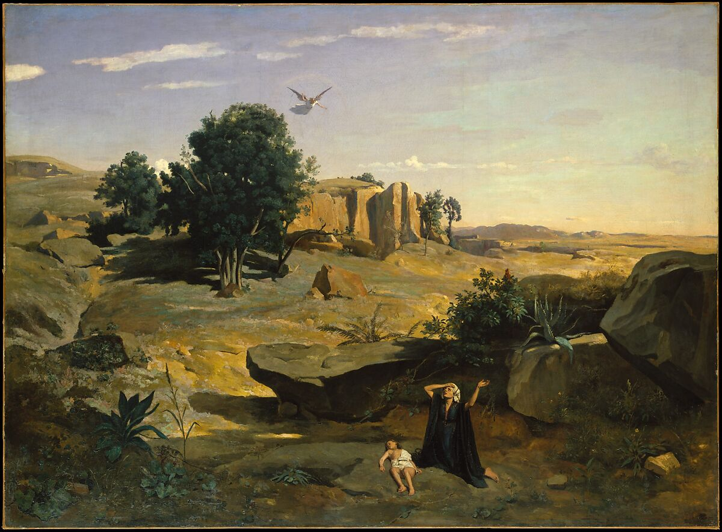
Heaven
Is Where
Your Heart Is
Notes:
Ge 16.13-14 Then she called the name of the Lord who spoke to her, “You are a God who sees”; for she said, “Have I even remained alive here after seeing Him?”
Therefore the well was called Beer-lahai-roi; …
Ge 21.14 …

Slide 39
Heaven
Is Where Your Heart Is
Matthew 6.19-21

